Slide 1
Objective structured picture examination{OSPE} practice sessions
Dr Babatola A.O
Department of Paediatrics
Afe Babalola University{ABUAD} Ado-Ekiti

Slide 2
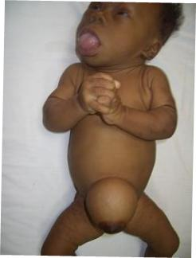
Concerning the clinical condition shown HYPOTHYROIDISM
A] It is twice as common in girls as in boys T
B] may be associated with prolongation of physiologic jaundice in the neonatal period conjugation, may be the earliest sign. T
C] Macrocytic anemia is often present T
D] In about 10% of cases there are associated congenital anomalies and nervous system anomalies are most common F
E]distal femoral epiphysis is often present at birth F

Slide 3
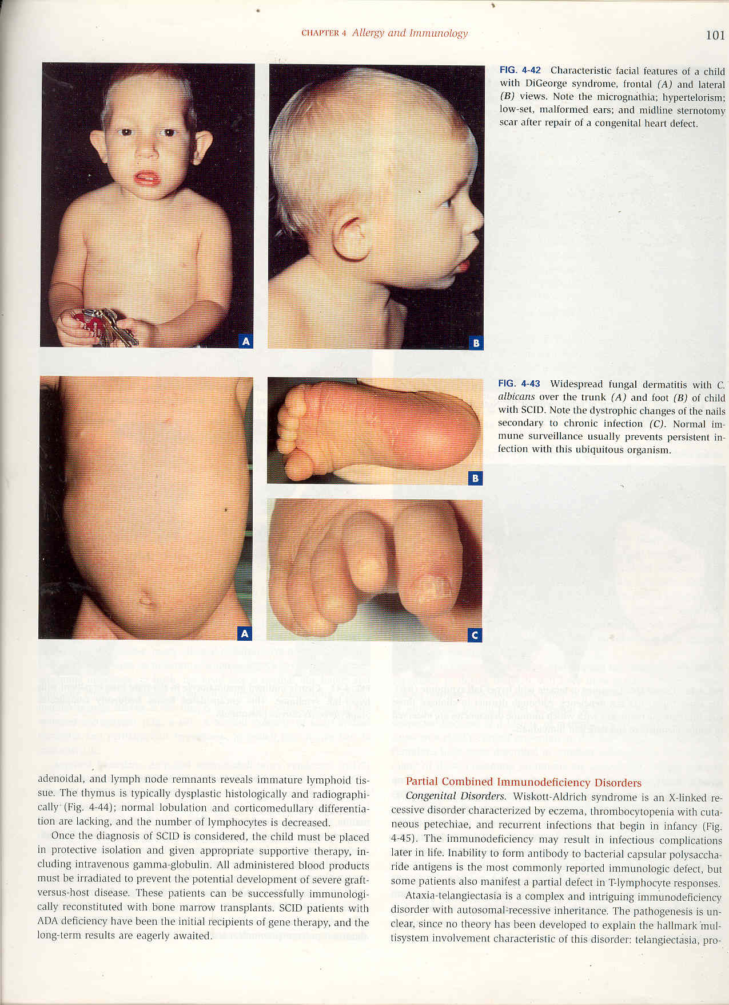
Of the picture shown below DOWN SYNDROME
A] child is most likely able to sit unsupported T
B] child is able to carry out thumb-finger grasp F
C] child can point to object F
D] child is at least 5 months old T
E]child cannot vocalise F

Slide 4
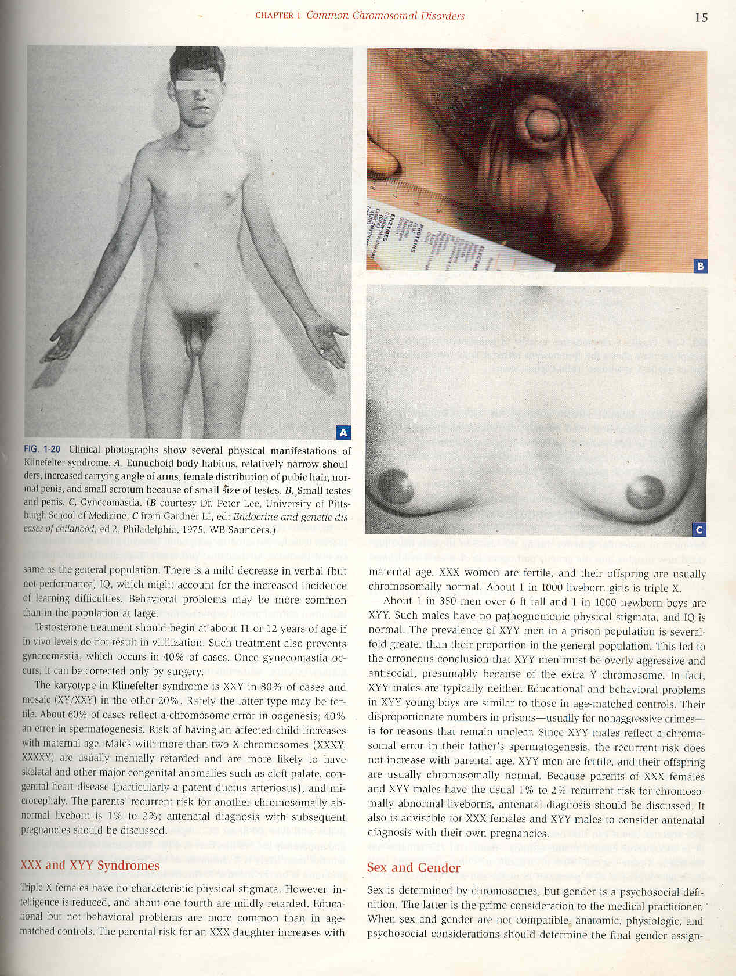
Concerning the condition shown below
A]Congenital Adrenal Hyperplasia could be a cause T
B]Metabolic acidosis may be a finding T
C]Glucocorticoid replacement is a treatment modality T
D] genetic counselling is important T
E) corticotrophin levels are elevated T

Slide 5
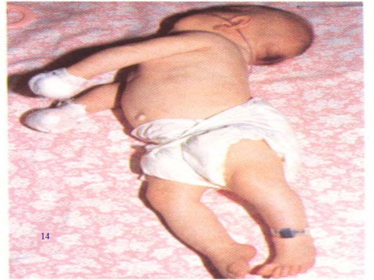
concerning the posturing below OPISTHOTINUS
A] Can be seen in patients with meningitis (T)
B} can be seen in patients with tetanus (T)
C] This is opisthotonous posturing (T)
D] This is Trendelenburg posturing (F)
E) patient is hypotonic (F)

Slide 6
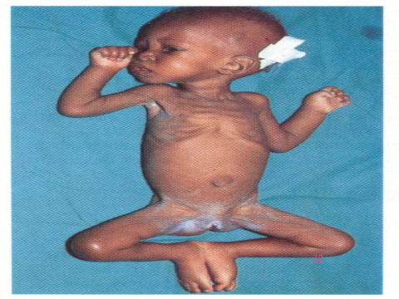
Of the patient below PEM
A)There can be associated sepsis T
b) peevish apathy is a constant feature T
C) weight of the child is <60% of the expected F
D) Hyponatremia portends good prognosis F
E)Iron supplement should be given early in the management of the patient F

Slide 7
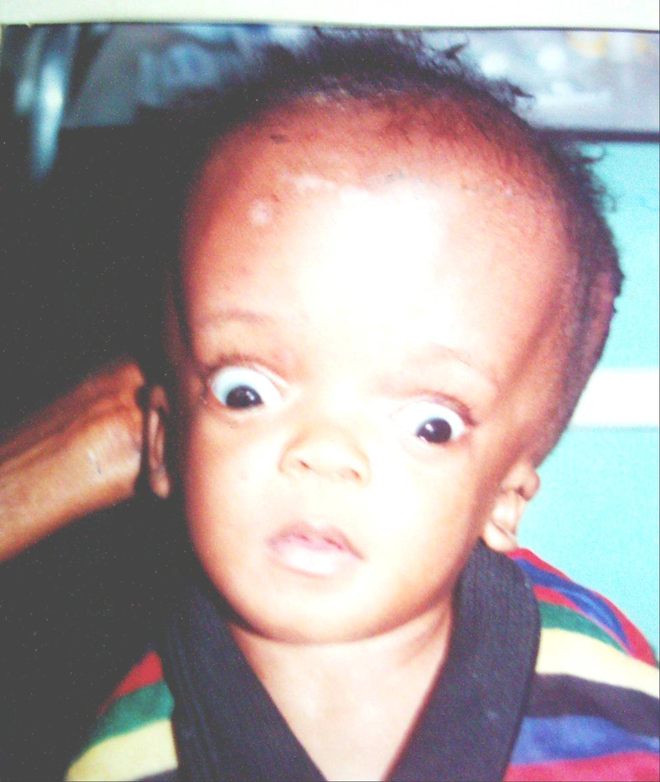
Concerning the patient below HYDROCEPHALUS
A) This condition could be a complication of meningitis T
B) Subarachnoid hemorrhage is a common cause of the obstructive form of this condition F
C) This child has setting sun eye sign T
D) Percussion of the skull can produce Macewen sign T
E) Dandy-Walker malformation can be a cause T

Slide 8
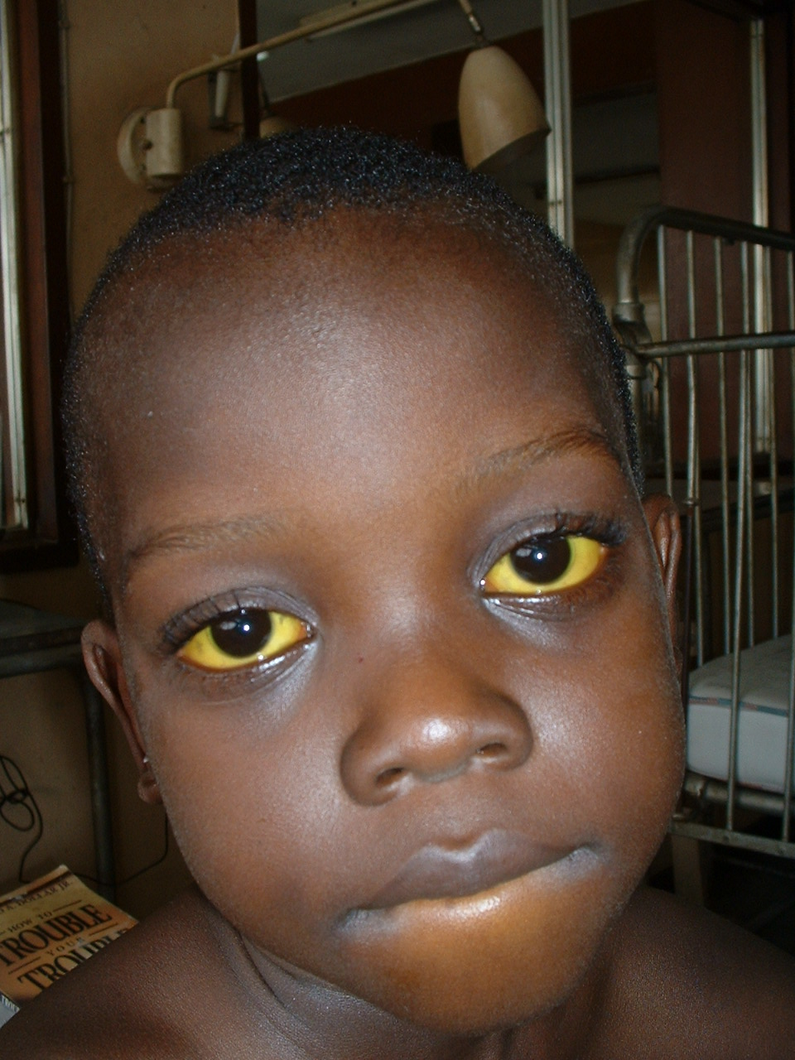
Concerning the patient below JAUNDICE
A) The sign demonstrated will manifest when the serum bilirubin is < 1mg/dl F
B) This can be seen in sickle cell anaemia T
C)There may be associated hemoglobinuria T
D) There can be associated pruritus T
E)blood film appearance may be helpful T

Slide 9
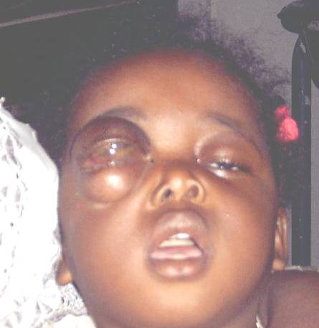
Of the patient below EXOPHTHALMUS
A]examination under anaesthesia may be indicated, T
B] Acute myeloid leukemia is a differential diagnosis T
C] child might have had white pupillary reflex in the past T
D] biopsy of the affected eye is indicated F
E] antibiotics may be indicated T

Slide 10
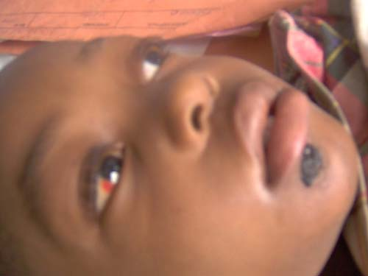
Concerning the patient below SUBCONJUCTIVAL HAEMORRHAGE
A] may have one of the vaccine preventable diseases T
B] trauma can be a cause T
C] bone marrow aspirate may be helpful T
D]white blood cell picture may show lymphocytosis T
E] none of the above is true F

Slide 11
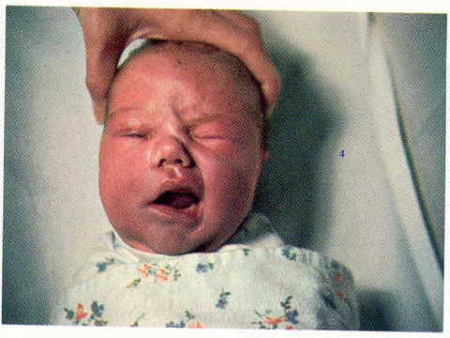
Concerning the patient below BELLS PALSY
A] trauma can be a cause T
B] steroids may be indicated
C] has left facial nerve palsy F
D] may develop exposure keratitis at night
E] varicella –zoster virus may be implicated

Slide 12
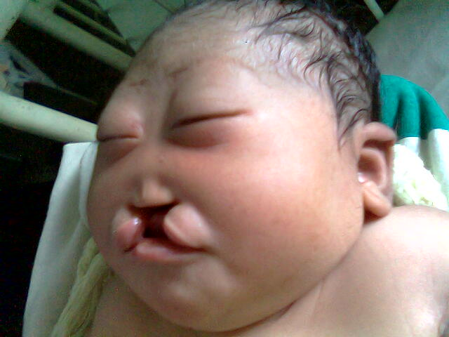
The newborn below BILATERAL CLEFT LIP
A] may have associated congenital anomalies T
B] is at risk of recurrent chest infections T
C] speech is never impaired F
D]this is more common in girls T
E] surgical repair is usually done at birth F

Slide 13
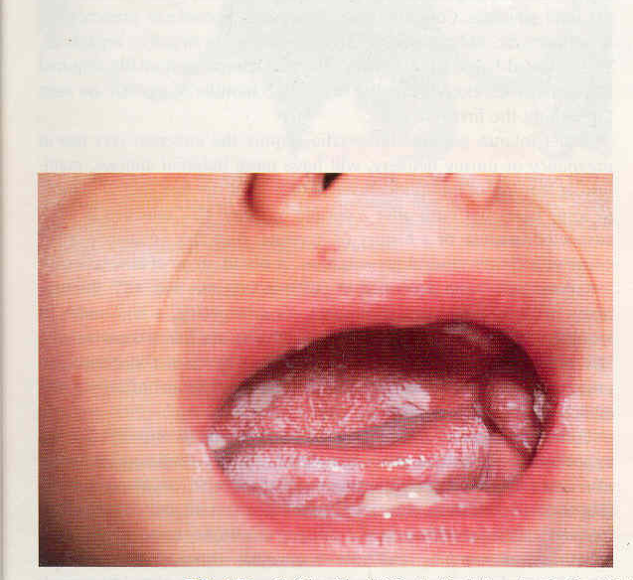
Concerning the picture below ORAL CANDIDIASIS/MILK CORD
A] treatment is antifungal agent F
B] may be present in patient with acquired immune deficiency syndrome T
C] there may be associated diarrhea T
D] the perineum should also be examined T
E] all of the above is correct F

Slide 14
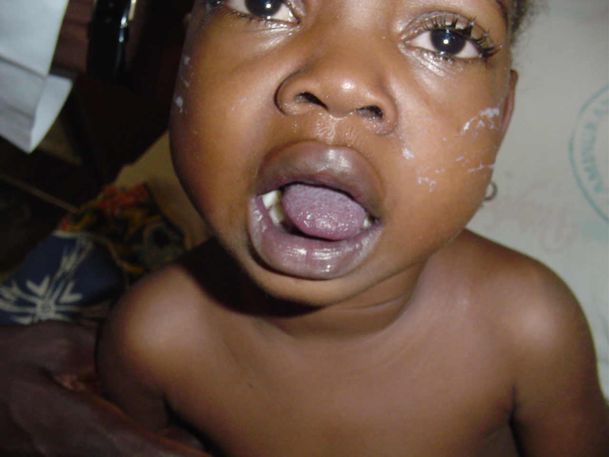
Concerning the patient below CENTRAL CYANOSIS
A] may require exchange transfusion T
B] there may be a history of frequent squatting T
C] hyperoxia test may be indicated T
D] treatment with sodium bicarbonate may be indicated T
E) child may have convulsions T

Slide 15
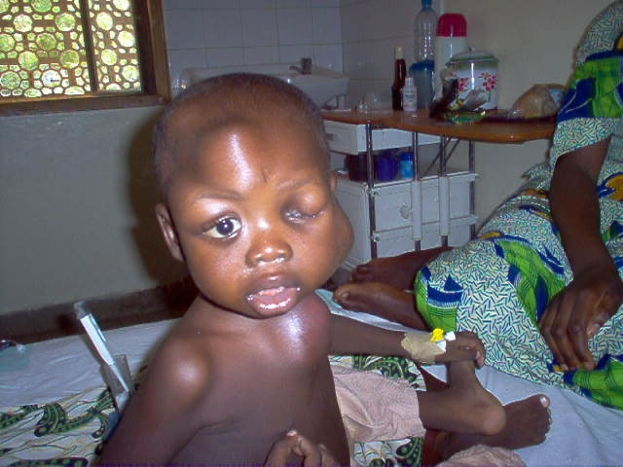
Concerning the patient below NEUROBLASTOMA
A} probably has nephroblastoma F
B] may have associated abdominal mass that cross the midline T
C] there is hypertension in 25% of cases F
D) may have horner syndrome associated with the condition T
E] surgery may be indicated T

Slide 16
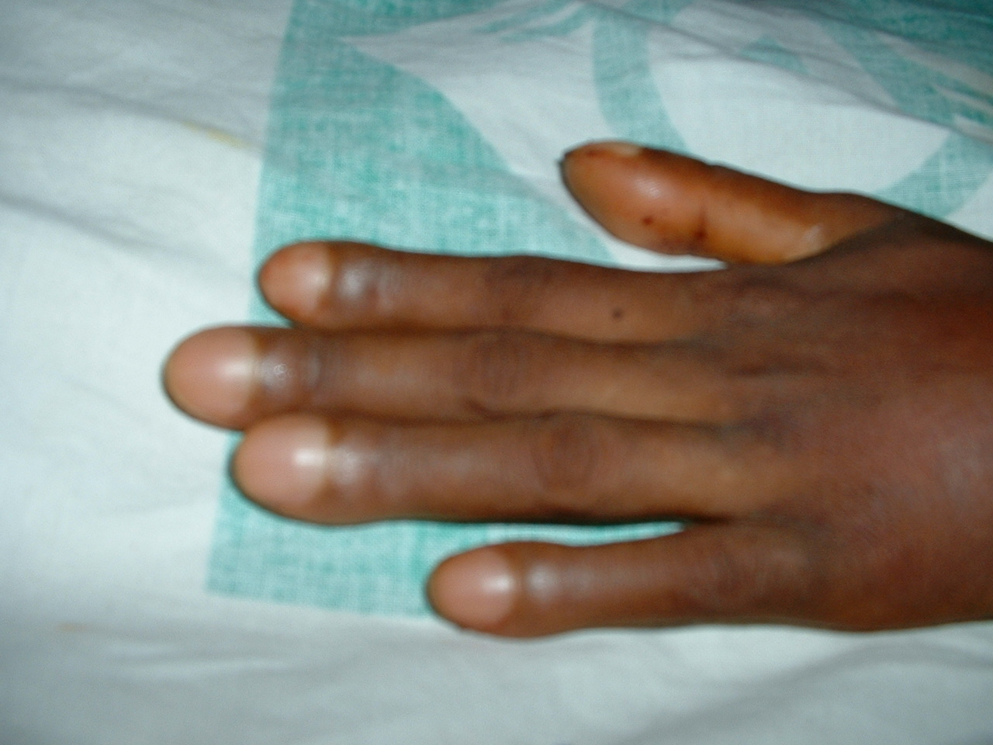
Concerning the patient below FINGER CLUBBING
A] cyanotic heart disease is a cause T
B] this is grade 1 finger clubbing F
C] chronic obstructive pulmonary disease is a cause T
D] acute respiratory distress syndrome is a cause F
E] none of the above statement is true F

Slide 17
THANK YOU FOR YOUR PARTICIPATION

